Slide 1
Overview
Transforms
Mathematical Introduction
Fourier Transform
Time-Space Domain and Frequency Domain
Discret Fourier Transform
Fast Fourier Transform
Summary
References

Slide 2
Transforms
Transform:
In mathematics, a function that results when a given function is multiplied by a so-called kernel function, and the product is integrated between suitable limits. (Britannica)
Can be thought of as a substitution

Slide 3
Transforms
Example of a substitution:
Original equation: x + 4x² – 8 = 0
Familiar form: ax² + bx + c = 0
Let: y = x²
Solve for y
x = ±√y
4

Slide 4
Transforms
Transforms are used in mathematics to solve differential equations:
Original equation
Apply Laplace Transform
Take inverse Transform: y = Lˉ¹(y)

Slide 5
Fourier Transform
Property of transforms:
They convert a function from one domain to another with no loss of information
Fourier Transform:
converts a function from the time (or spatial) domain to the frequency domain

Slide 7
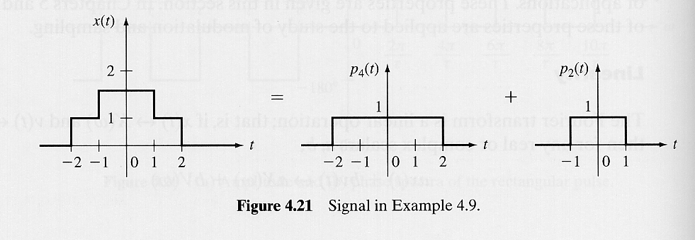
Example: Linearity

Slide 8
Example: Time Shift

Slide 9
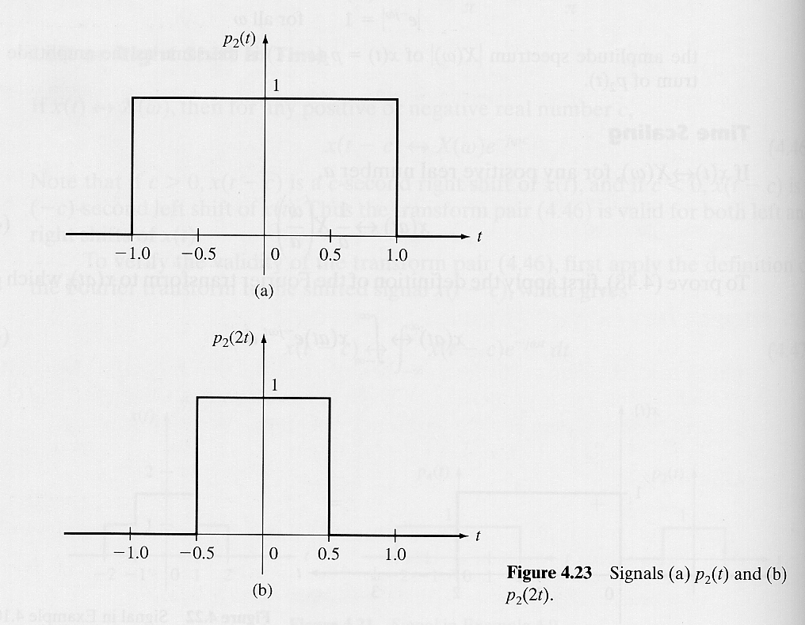
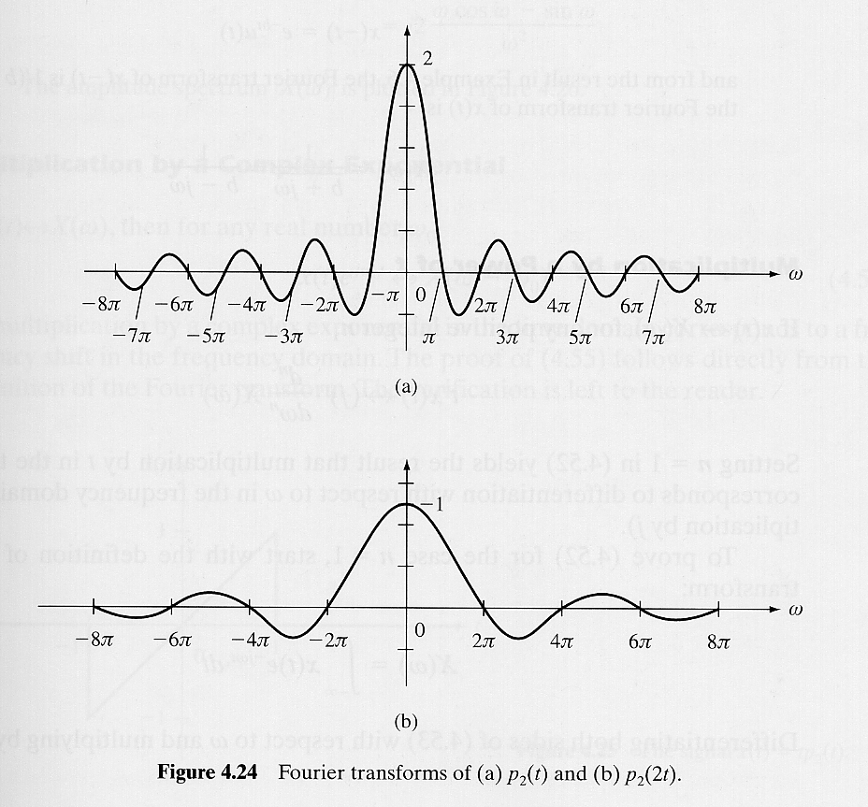
Example: Time Scaling
time compression frequency expansion
time expansion frequency compression

Slide 10
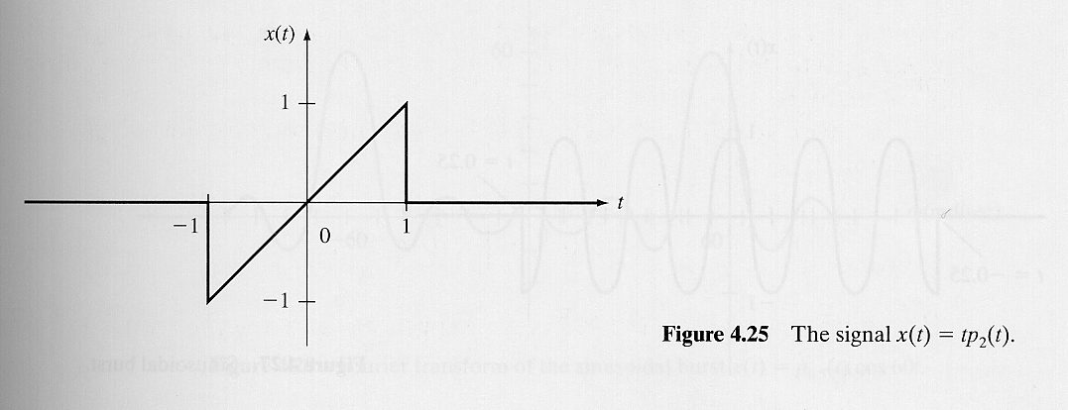
Example: Multiplication in Time

Slide 11
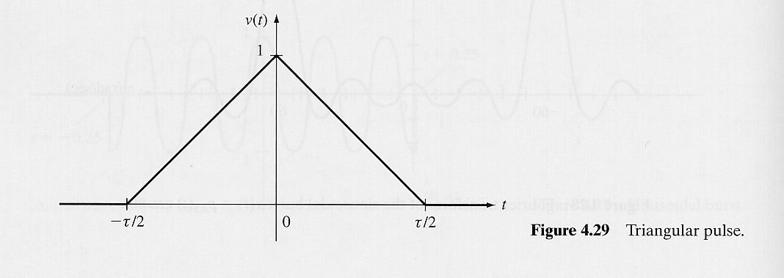
Example: Integration in the Time Domain

